Slide 1
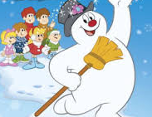
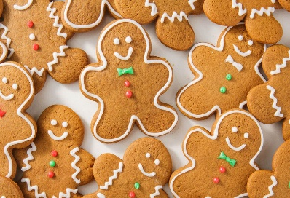
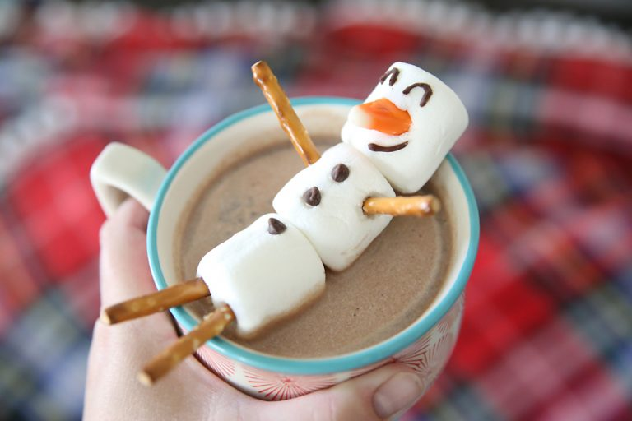
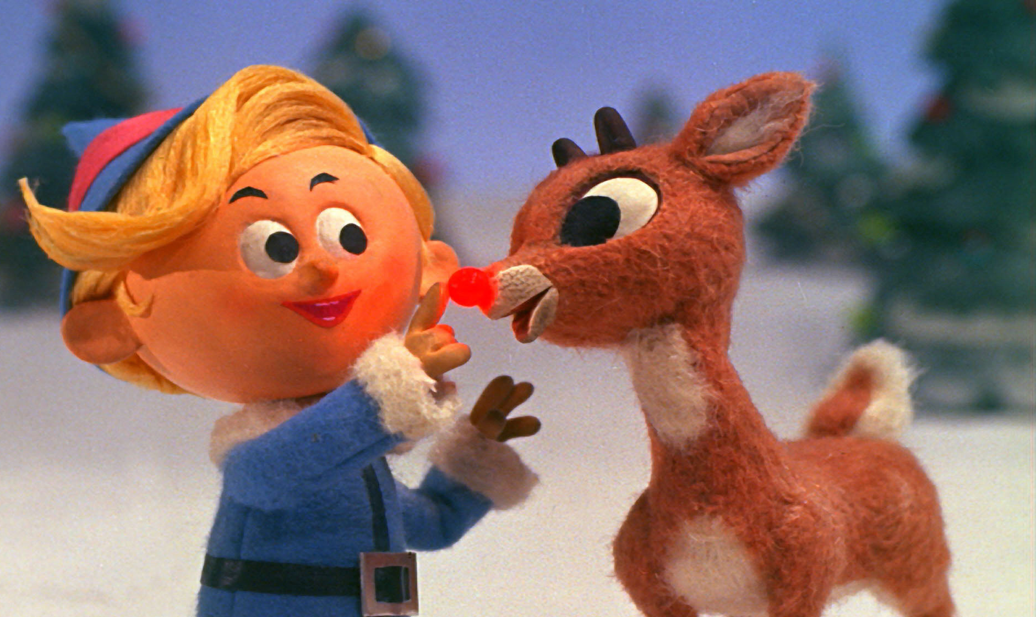
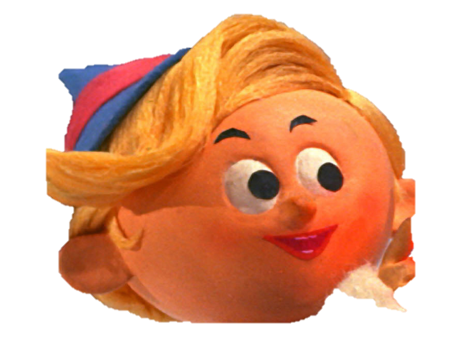
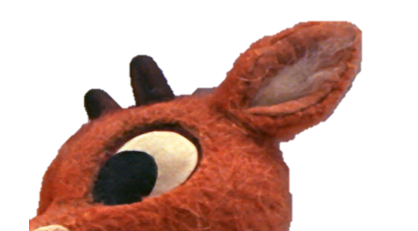
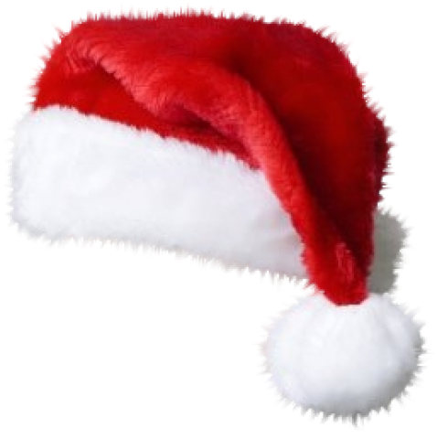
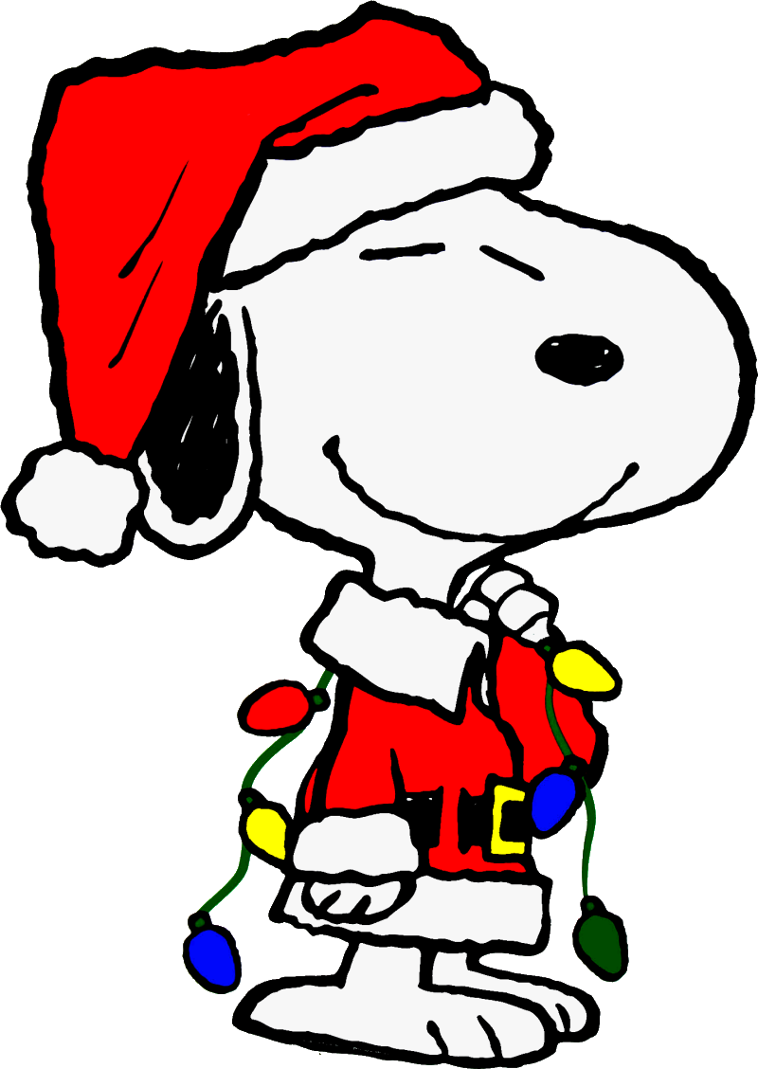
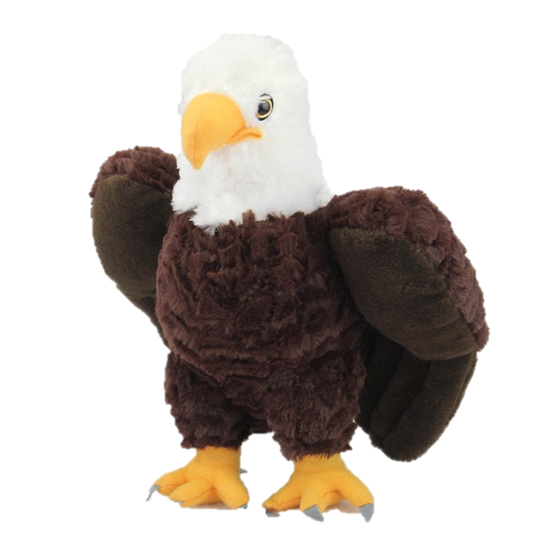
Happy Holidays From
Dr. Parkman and Harry!

Slide 2
Happy Holidays From
Dr. Parkman and Harry!
We hope each of you enjoy the holidays creating memories with your family. We hope you SOAR throughout the season being kind to others and spreading cheer. We hope you remember that it’s not about the presents even though we enjoy getting them, but we can be very merry without any presents at all. Harry and I will be busy throughout the holidays watching Christmas movies, singing Christmas carols, riding to see Christmas lights, visiting National Hills Baptist Church Nativity Scene, playing games, baking, and more. We hope you enjoy Harry’s favorite Christmas story, “How The Grinch Stole Christmas”. We hope that like the Whos, you will share the spirit of Christmas and be thankful for being able to spend time with family.

Slide 3
Happy Holidays From
Dr. Parkman and Harry!
Video not playing? Click on the link to enjoy the story. https://youtu.be/Ty_V5h12RHw

Slide 4
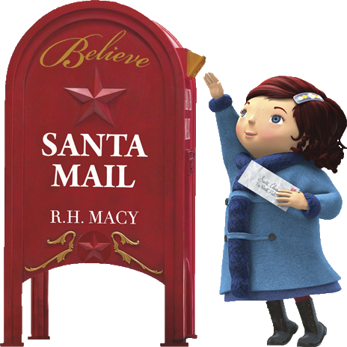
Happy Holidays From
Dr. Parkman and Harry!
Spread Some Holiday Cheer! Send an electronic letter to Santa to help grant a Christmas wish of a sick child this Christmas. For each letter sent, Macy’s will donate $1 up to a million dollars to the Make A Wish Foundation. This is another way Garrett Eagles can SOAR during the holidays spreading cheer!
Click on the link to send your letter. www.macys.com/social/believe

Slide 5
Happy Holidays From
Dr. Parkman and Harry!
SEE YOU NEXT YEAR!
Click on the link to send your letter. www.macys.com/social/believe

